Slide 1

DOM
Document Object Model
SoftUni Team
Technical Trainers
Software University
https://softuni.bg

Slide 2
Table of Contents
What is DOM?
DOM Manipulations
Parents and Children Elements
DOM Properties
HTML Attributes
Event Handling

Slide 3
Traverse the DOM Tree
Document Object Model (DOM)

Slide 4

Document Object Model
What is Document Object Model (DOM)?
HTML documents in the browser are stored as "DOM tree"
Consists of elements with child elements (nodes)
Elements have properties (attribute + value) and events
DOM is a standard of how to
Get HTML element
Change HTML element
Add HTML element
Delete HTML element

Slide 5
HTML DOM
The HTML DOM is an Object Model for HTML
HTML elements as objects
Properties for all HTML elements
Methods for all HTML elements
Events for all HTML elements

Slide 6

Modify the DOM Tree
DOM Manipulations

Slide 7
Selection of Elements
There are a few ways to find a certain HTML element in the DOM
By id - getElementById()
By tag name - getElementsByTagName()
By class name - getElementsByClassName()
By CSS selector - querySelector()

Slide 8
CSS Selectors
CSS selectors are strings that follow CSS syntax for matching
They allow very fast and powerful element matching, e.g.
"#main" - returns the element with ID "main"
"#content div" - selects all <div>'s inside #content
".note, .alert" - all elements with class "note" or "alert"
"input[name='login']" - <input> with name "login"

Slide 9

DOM Manipulations
The HTML DOM allows JavaScript to change the content of HTML elements
innerHTML
attributes
setAttribute()
style.property

Slide 10
DOM Manipulations
We can create, append and remove HTML elements dynamically
removeChild()
appendChild()
replaceChild()
document.write()

Slide 11
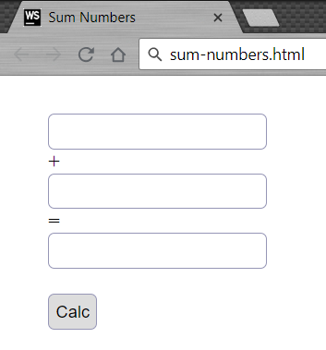
Problem: Sum Numbers
Write a function to sum two numbers (fill the missing code)
<input type="text" id="num1" /> +
<input type="text" id="num2" /> =
<input type="text" id="sum" readonly="readonly" />
<input type="button" value="Calc" onclick="calc()" />
<script>
function calc() {
// TODO: sum = num1 + num2
}
</script>

Slide 12
Solution: Sum Numbers
function calc() {
let num1 = document.getElementById('num1').value;
let num2 = document.getElementById('num2').value;
let sum = Number(num1) + Number(num2);
document.getElementById('sum').value = sum;
}

Slide 13
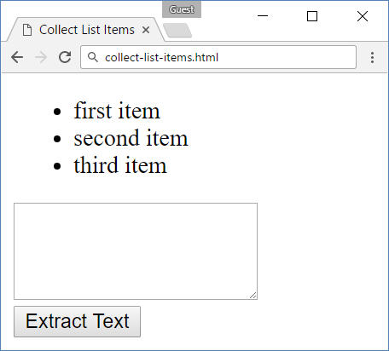
Problem: Collect List Items
Collect the list items from given HTML list and append their text to given text area
<ul id="items">
<li>first item</li>
<li>second item</li>
<li>third item</li>
</ul>
<textarea id="result"></textarea>
<br>
<button onclick="extractText()"> Extract Text</button>

Slide 14
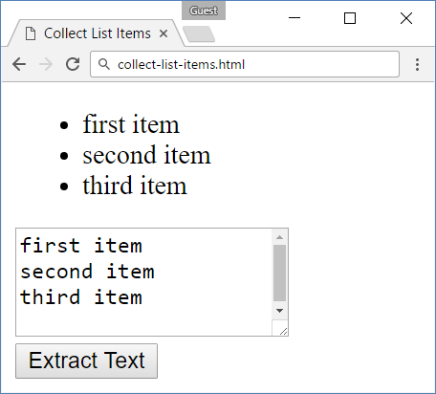
Solution: Collect List Items
function extractText() {
let itemNodes = document.querySelectorAll("ul#items li");
let textarea = document.querySelector("#result");
for (let node of itemNodes) {
textarea.value += node.textContent + "\n";
}
}

Slide 15
Creating DOM Elements
HTML elements are created with document.createElement()
Text added to textContent will be escaped
Text added to innerHTML will be parsed and turned into actual HTML elements
The above code creates a new elements. But these elements don't exist anywhere except as values inside variables
Tag name
let p = document.createElement("p");
let li = document.createElement("li");

Slide 16
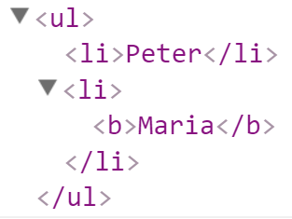
Creating DOM Elements
Variables holding HTML elements are live
If you modify the contents of the variable, the DOM is updated
If you insert it somewhere in the DOM, the original is moved
let list = document.createElement("ul");
let firstLi = document.createElement("li");
firstLi.textContent = "Peter";
list.appendChild(firstLi);
let secondLi = document.createElement("li");
secondLi.innerHTML = "<b>Maria</b>";
list.appendChild(secondLi);
document.body.appendChild(list);

Slide 17
Deleting DOM Elements
<div id="div1">
<p id="p1">This is a paragraph.</p>
<p id="p2">This is another paragraph.</p>
</div>
let parent = document.getElementById("div1");
let firstChild = document.getElementById("p1");
let secondChild = document.getElementById("p2");
firstChild.remove();
parent.removeChild(secondChild);
Directly deleting
Deleting by parent element

Slide 18

DOM Properties and HTML Attributes

Slide 19
Properties vs. Attributes
Attributes are defined by HTML
Properties are defined by the DOM
Attributes initialize DOM properties
Property values can change
Attribute values can't
The HTML attribute and the DOM property are not the same thing, even when they have the same name

Slide 20
DOM Properties
textContent - reads and writes text
innerHTML - returns and writes the HTML of a given element
value - gets and sets value
let text = Node.textContent;
Node.textContent = 'New text for element.';
let html = myElement.innerHTML;
myElement.innerHTML = 'New text for element.';
let theValue = theFormField.value;
theFormField.value = 'New value';

Slide 21
HTML Attributes and Methods
getAttribute() - returns the value of attributes of specified HTML element
<input type="text" name="username"/>
<input type="password" name="password"/>
const inputEl = document.getElementByTagName('input')[0];
inputEl.getAttribute('type'); // text
inputEl.getAttribute('name'); // username

Slide 22
HTML Attributes and Methods
setAttribute() - sets the value of an attribute on the specified HTML element
<input type="text" name="username"/>
<input type="password" />
const inputPassEl = document.getElementsByTagName('input')[1];
inputPassEl.setAttribute('name', 'password');
<input type="text" name="username"/>
<input type="password" name="password"/>

Slide 23
HTML Attributes and Methods
removeAttribute() - removes the attribute with the specified name from an HTML element
<input type="text" name="username" placeholder="Username..."/>
<input type="password" name="password" placeholder="Password..."/>
const inputPassEle = document.getElementsByTagName('input')[1];
inputPassEle.removeAttribute('placeholder');
<input type="text" name="username" placeholder="Username..."/>
<input type="password" name="password"/>

Slide 24
HTML Attributes and Methods
hasAttribute() - method returns true if the specified attribute exists, otherwise it returns false
<input type="text" name="username" placeholder="Username..."/>
<input type="password" name="password" id="password"/>
const passwordElement = document.getElementById('password');
passwordElement.hasAttribute('name'); // true
passwordElement.hasAttribute('placeholder'); // false

Slide 25
HTML Attributes and Methods
classList - is a read-only property that returns a collection of the class attributes of specified element
<div class="container div root"></div>
const element = document.getElementById('myDiv').classList;
// DOMTokenList(3) ["container", "div", "root", value: "container div root"]

Slide 26
HTML Attributes and Methods
classList methods
add() - Adds the specified class values
remove() - Removes the specified class values
<div class="container div root"></div>
document.getElementById('myDiv').classList.add('testClass');
<div class="container div root testClass"></div>
document.getElementById('myDiv').classList.remove('container');
<div class="div root testClass"></div>

Slide 27

Parents and Child Elements

Slide 28
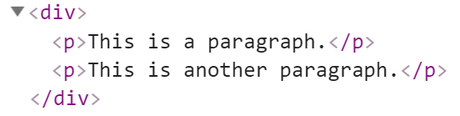

Parents and Child Elements
Every DOM Elements has a parent
Parents can be accessed by keywords .parent or .parentNode
Accessing the first child
let firstP = document.getElementsByTagName('p')[0];
console.log(firstP.parent);
Accessing the child parent

Slide 29
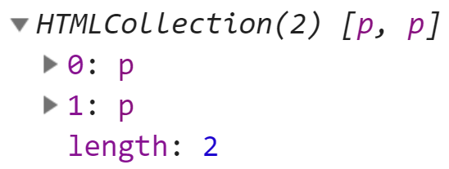
Parents and Child Elements
When some element contains other elements, that means he is parent of this elements
Also this elements is children to the parent. They can be accessed by keyword .children
let pElements = document.getElementsByTagName('div')[0].children;
Returns HTML Collection

Slide 30
Parents and Child Elements
appendChild() - Adds a new child, as the last child
prepend() - Adds a new child, as the first child
let p = document.createElement("p");
let li = document.createElement("li");
li.appendChild(p);
let ul = document.getElementById("my-list");
let li = document.createElement("li");
ul.prepend(li);

Slide 31

DOM Events
Handling DOM Events

Slide 32
DOM Events
Events are actions or occurrences
They allow JavaScript to register different event handlers on elements
Events are normally used in combination with functions, and the function will not be executed before the event occurs
htmlRef.addEventListener( 'click' , handler );

Slide 33
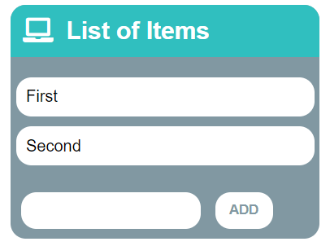
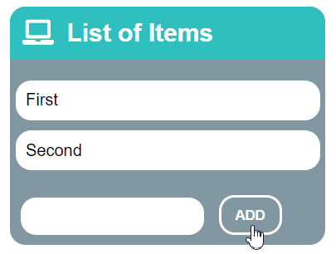
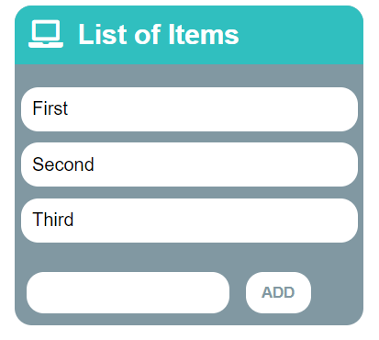
Problem: List of Items
Create a HTML page holding a list of items + text box + button for adding more items to the list
Write a function to append the specified text to the list

Slide 34
Problem: List of Items – HTML
<h1>List of Items</h1>
<ul id="items"><li>First</li><li>Second</li></ul>
<input type="text" id="newItemText" />
<input type="button" value="Add" onclick="addItem()">
<script>
function addItem() {
// TODO: Add new item to the list
}
</script>

Slide 35
Solution: List of Items
function addItem() {
let text = document.getElementById('newItemText').value;
let li = document.createElement("li");
li.appendChild(document.createTextNode(text));
document.getElementById("items").appendChild(li);
document.getElementById('newItemText').value = '';
}
addItem();

Slide 36
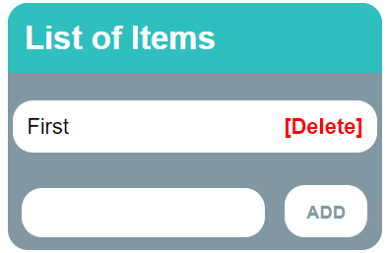
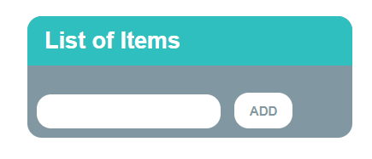
Problem: Add / Delete Items
Extend the previous problem
Implement [Delete] action as link after each list item

Slide 37
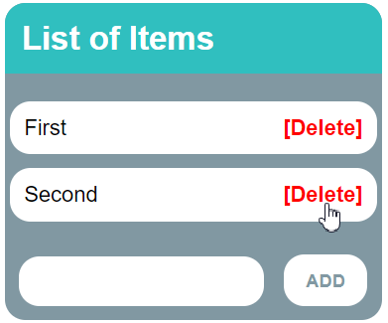
Problem: Add / Delete Items – HTML
<h1>List of Items</h1>
<ul id="items"></ul>
<input type="text" id="newText" />
<input type="button" value="Add" onclick="solve()">
<script>
function solve() { // TODO...
}
</script>

Slide 38
Solution: Add / Delete Items
function solve() {
let newElement = document.getElementById("newText").value;
let list = document.getElementById("items"); if (newElement.length === 0) return; let listItem = document.createElement("li");
listItem.textContent = newElement; let remove = document.createElement("a");
let linkText = document.createTextNode("[Delete]");
remove.appendChild(linkText);
remove.href = "#";
remove.addEventListener("click", deleteItem);
listItem.appendChild(remove);
list.appendChild(listItem);
function deleteItem() {
listItem.remove();
}
}

Slide 39

Summary
Browsers keep elements as DOM tree
Finding / modifying DOM elements
Handling events
…
…
…
let menu = document.getElementById('menu');
menu.style.display = 'none';
menu.appendChild(
document.createElement('hr'));
let menu = document.getElementById('menu');
menu.onclick = function(event) { … }

Slide 40
Questions?
Notes:
40

Slide 41












SoftUni Diamond Partners

Slide 42




SoftUni Organizational Partners

Slide 43
Trainings @ Software University (SoftUni)
Software University – High-Quality Education, Profession and Job for Software Developers
softuni.bg, softuni.org
Software University Foundation
softuni.foundation
Software University @ Facebook
facebook.com/SoftwareUniversity
Software University Forums
forum.softuni.bg
Notes:
43

Slide 44

License
This course (slides, examples, demos, exercises, homework, documents, videos and other assets) is copyrighted content
Unauthorized copy, reproduction or use is illegal
© SoftUni – https://softuni.org
© Software University – https://softuni.bg
Notes:
44

